Slide 1
Best players in PL 2015-2021
By: Ahmed Bedair

Slide 2
Introduction
It’s hard to define the best player in specific time but here we’ll try to define the best player in each Centre (Goalkeepers, Forwards, Defenders, Midfielders) according to their efficiency in their roles in the playground between 2015-2021.

Slide 3
Evaluation Criteria
We picked top 5 players in the most important roles in their position
Players should’ve played more than 60 matches

Slide 4
Best Goalkeeper

Slide 5
Best Goalkeeper(GK)
“Goalkeepers is the half of the team” This quote is the best description for the GK that he is the protector of the team’s net from goals by his saves and catches in hard matches
Some of Modern football coaches give the GK more roles for controlling the team and making accurate long passes to give the ball away and help the forwards to score and we’ll show you some stats for the best GKS according to their roles

Slide 6
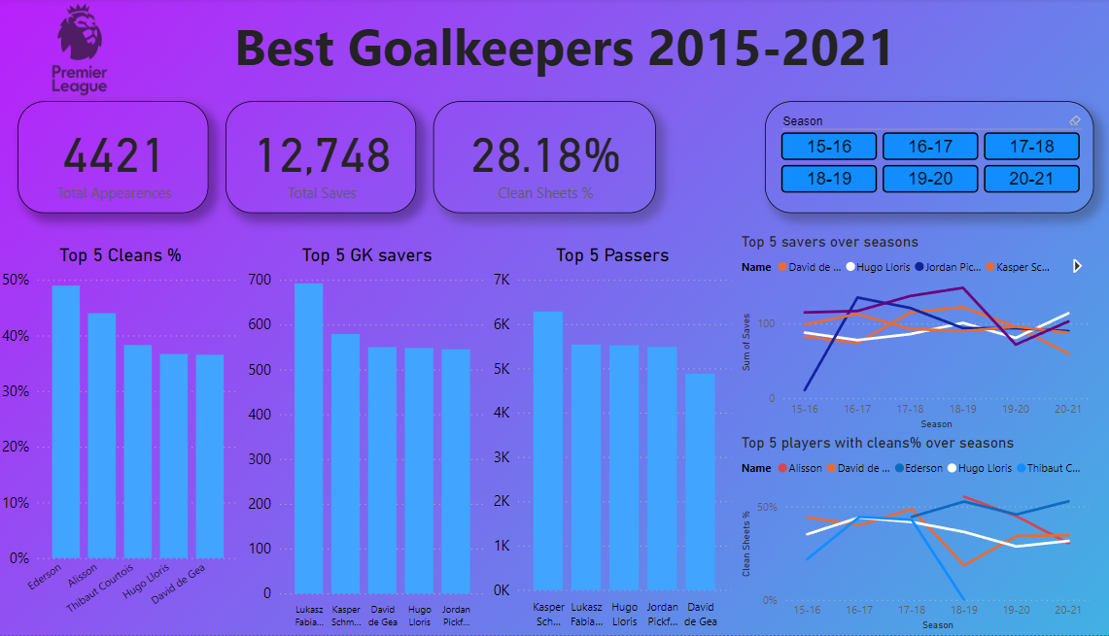
Dashboard

Slide 7
Notes from Dashboard
In all charts we’ll find 2 GKS (David de Gea, Hugo Lloris)
We’ll find De Gea is better In saves but Lloris is better at passing and his clean sheets % is higher
We’ll find in season 18-19 that De Gea have high saves in the line chart but very low in clean sheet% that I think it’s not his fault but maybe the defenders was bad in this season that in my opinion David de Gea and Hugo Lloris are the best in this time

Slide 8
Best Defender

Slide 9
Best Defender (DEF)
Defender is the one of the most important positions in the Modern football that the defender is the one who builds the play of the team and prevent the forwards to reach the penalty area and score goals
There are many metrics to define the best defender that there are two types of them (backs and center DEF) that the center focus on building games and defending but the backs are more offensive and help the forward to reach the penalty area and score goals

Slide 10
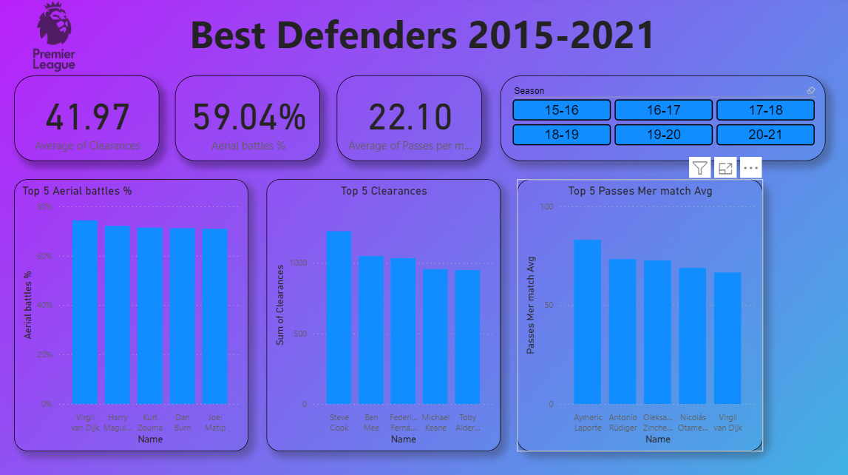
Dashboard

Slide 11
Notes from Dashboard
Virgil Van Dijk is the best with Aerial battles that he successed in 74% of it and he is the best passer that he has the highest passes per match avg over seasons
So, Virgil is the best defender at this time

Slide 12
Best Midfielder

Slide 13
Best Midfielder(MDF)
In my opinion Midfielders are the heart of the team that they are connecting between defenders and forward and delivering the ball to the penalty area of the opponent
There are two types of midfielders defensive type to help defenders and cutting ball to preventing it from reaching the penalty area of the team and the offensive to deliver the ball to the penalty area of the opponent

Slide 14
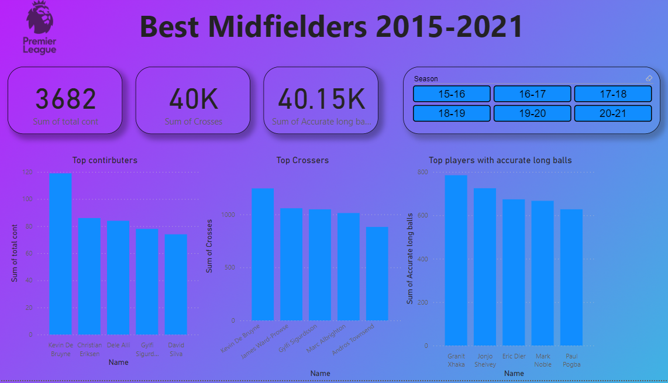
Dashboard

Slide 15
Notes from Dashboard
Kevin de bruyne is the best contributor that he scored goals and made assists more than any one in his position and he is the best crosser that made
So, Kevin is the best midfielder at this time

Slide 16
Best Forward

Slide 17
Best Forward(FWD)
Forwards are the actual key of winning football games that without their goals the effort of other players is useless that they transforms their effort to goals to win Games

Slide 18
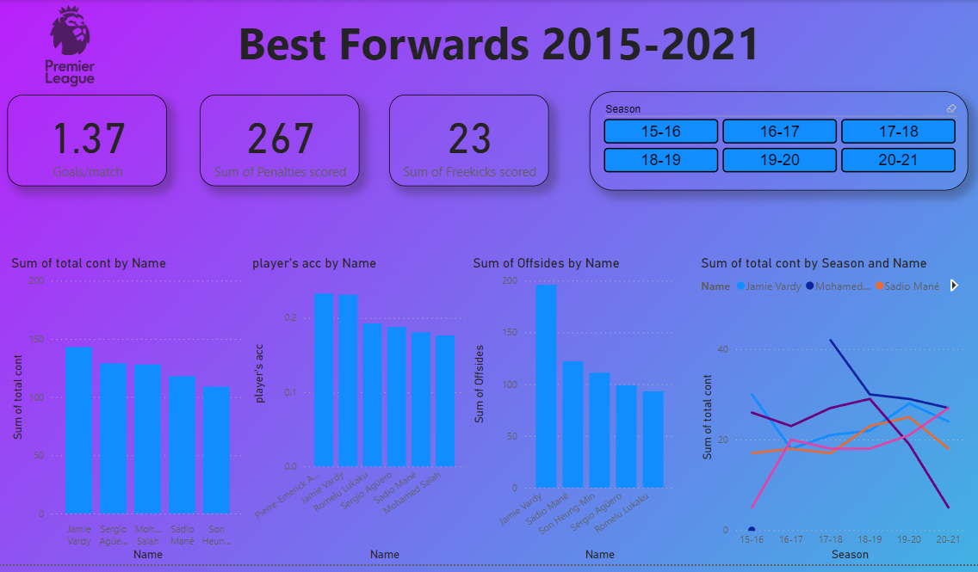
Dashboard

Slide 19
Notes from Dashboard
Jamie Vardy is the best contributor that he scored goals and made assists more than any one in his position and he has the highest scoring accuracy equal to Pierre Emerick Aubameyang
Even Vardy he has the most offsides that means that he reaches the penalty line very much
So, Jamie Vardy is the best forward player at this time

Slide 20
Thank You

